Slide 1
Growth of Metal Silicides from Metal Flux Reactions
Susan E. Latturner
Department of Chemistry
Florida State University
I. Metal flux synthesis
Zintl phases and Thermoelectric materials
Metal silicides A/Mg/Si (A = Ca, Sr, Ba, Eu, Yb)

Slide 2
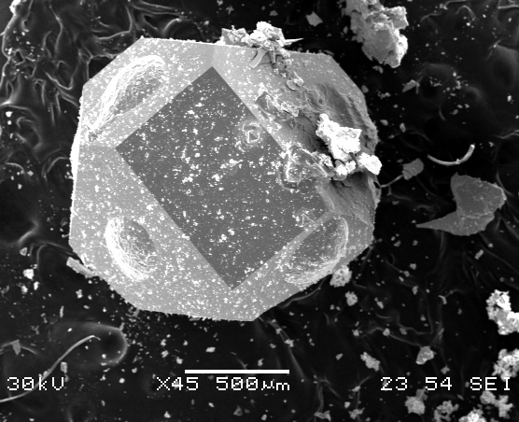
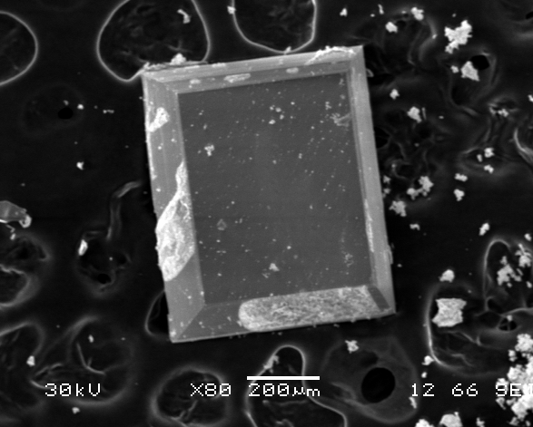
Metal Flux Synthesis
Metal flux synthesis: reaction where one low-melting metal reactant is present in large excess, acting as a solvent.
Common metal fluxes and products
Tin flux: PrCo₂P₂, BaFe₂As₂, Co₇Zn₃Sn₈
Aluminum flux: Co₄Al₁₃, Y₂Al₃Si₂, CeNiAl₄Ge₂, U₈Al₁₉Si₆
Gallium flux: Mn₁₂₃Ga₁₃₇, Yb₃Ga₄Ge₆, Tb_{1.8}Si₈C₂B₃₆
Flux synthesis advantages:
Low temperatures--kinetic/metastable products
Liquid state reaction--crystal growth
Exploratory synthesis: allows reactants to find product with local energy minimum structure

Slide 3
Metal Flux Synthesis
Combine reactants, add excess amount of suitable flux metal
Heat above mp of flux, slowly cool
Centrifuge while flux still molten
Unknown precipitations, phase transitions
Quartz tube
Temp (°C)
Quartz wool for separation of product from flux
Centrifuge
or cool and then etch
Crucible containing flux + reactants
Time (hr)

Slide 4
Characterization of product compounds
What’s in it?
Elemental analysis to determine what elements were incorporated
SEM-EDS
What is the structure?
Single crystal XRD to determine positioning of elements
What other products were formed?
Powder XRD to determine purity, yield
What are its properties?
Band structure calculations to explore electronic structure
Magnetic susceptibility
Thermoelectric/transport measurements

Slide 5
Intermetallics and Zintl Phases
Intermetallic compounds: Compounds comprised of two or more metals or metalloids
Zintl phases: Subclass of Intermetallics. Compounds comprised of electropositive metal (Group 1, Group 2, some RE) and metalloid
Charge transfer between electropositive metal and electronegative metalloids leads to metal cations and metalloid anions that are charge-balanced. Causes semi-metallic or semiconducting behavior
Often have complex structures
Metal + metal metal + metalloid metal + nonmetal
Alloys Zintl phases Ionic salts
Cu_{x}Ni_{1-x} Mg₂Si, Na₄Sn₉ MgO, NaCl
Metallic semimetal/semiconductor insulator

Slide 6
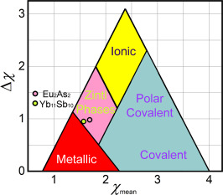
Classifying compounds based on differences in electronegativity χ
Electronegativity χ = 1 – 2 for metals χ = 2.5 – 4 for nonmetals

Slide 7
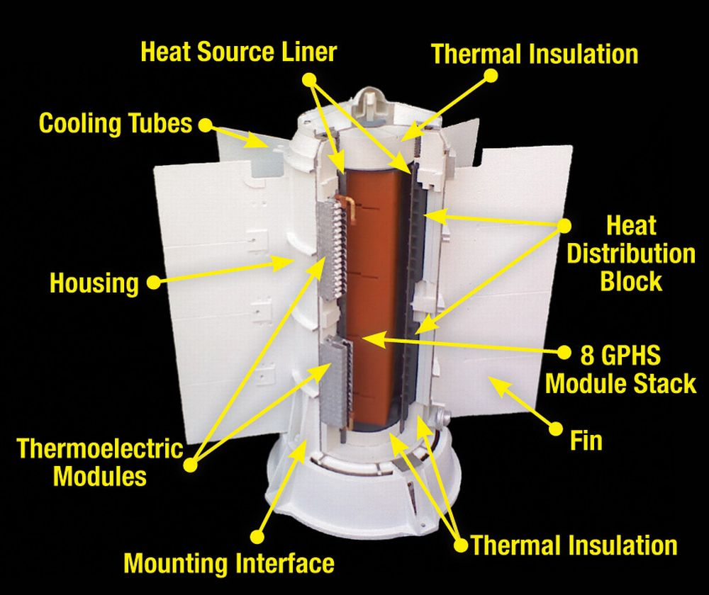
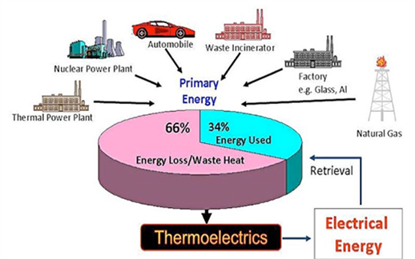
Thermoelectric materials
Generate a voltage when a temperature gradient is applied
Used as: power sources (makes use of waste heat)

Slide 8
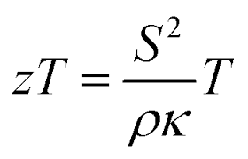
Thermoelectric materials
To maintain thermal gradient while producing a voltage, compound must have:
Low thermal conductivity κ
High electrical conductivity σ (low electrical resistivity ρ)
High Seebeck coefficient S (voltage / ΔT)
Thermoelectric figure of merit:

Slide 9
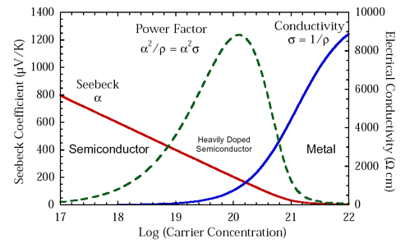
Thermoelectric materials
Problem: ρ and S are interrelated!
Best balance: Doped semiconductors/semimetals: Bi₂Te₃, Yb₁₄MnSb₁₁, PbTe. Or…Zintl phases!
κ is relatively independent, make as low as possible (heavy elements, complex structure, disorder)

Slide 10
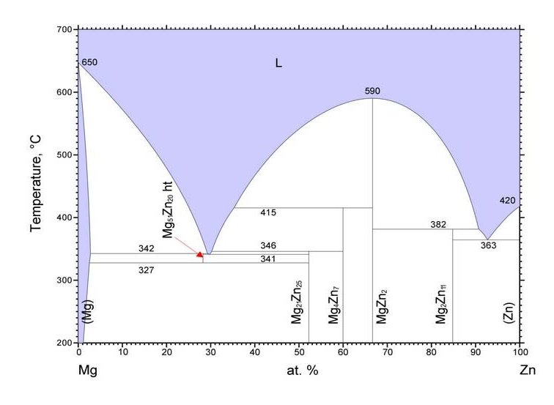
Magnesium-based fluxes: Mg/Al or Mg/Zn
Adding Al or Zn lowers Mg m.p. Using 22 mmol Mg, 8 mmol of Zn or Al.
Silicon reacts with divalent metals (A = Ca, Sr, Ba, Eu, Yb) in Mg-rich melt
Large family of new A/A’/Mg/Si compounds
Charge-balanced Zintl phases
Al or Zn not incorporated into products

Slide 11
Ternary A/Mg/Si products
What determines structure and composition of product?
Ionic radii of A²⁺ cations
Reactant ratio
Heating profile/cooling rate
Cation | Radius (Å)
Mg²⁺ | 0.86
Ca²⁺ | 1.14
Sr²⁺ | 1.32
Ba²⁺ | 1.49
Eu²⁺ | 1.31
Yb²⁺ | 1.16
Possible complication with Eu and Yb: They can be trivalent
Yb³⁺ radius: 1.01 Å
Eu³⁺ radius: 1.09 Å

Slide 12
Ternary A/Mg/Si products
CaMgSi
A = Ca
Mg/Zn + Si + A
A = Yb
Yb₂MgSi₂
A = Sr
A = Eu
A = Ba
Sr_{5+x}Mg_{19-x}Si₁₂
Eu_{5+x}Mg_{19-x}Si₁₂
Ba₅Mg₁₉Si₁₂
Smaller A cations: give orthorhombic TiNiSi – type product (CaMgSi) or tetragonal U₃Si₂ – type product (Yb₂MgSi₂)
Larger A cations: give hexagonal Ho₅Ni₁₉P₁₂ – type products

Slide 13
CaMgSi
TiNiSi type
Orthorhombic
Space group Pnma
a = 7.4690(2)Å
b = 4.4255(1)Å
c = 8.3113(2)Å
(Ca²⁺)(Mg²⁺)(Si⁴⁻)
Zintl phase, semimetal
Si anions surrounded by 9 cations
Si@(Ca/Mg)₉ shown in polyhedral mode

Slide 14
Yb₂MgSi₂
Mo₂FeB₂ type
Tetragonal
Space group P4/mbm
a = 7.0495(1)Å
c = 4.1313(1)Å
Contains Si-Si unit, formally [Si₂⁶⁻]
Zintl phase: (Yb²⁺)₂(Mg²⁺)[Si₂⁶⁻]
…if the Yb is +2! Reports indicate it is Yb³⁺
Yb
Mg
Si

Slide 15
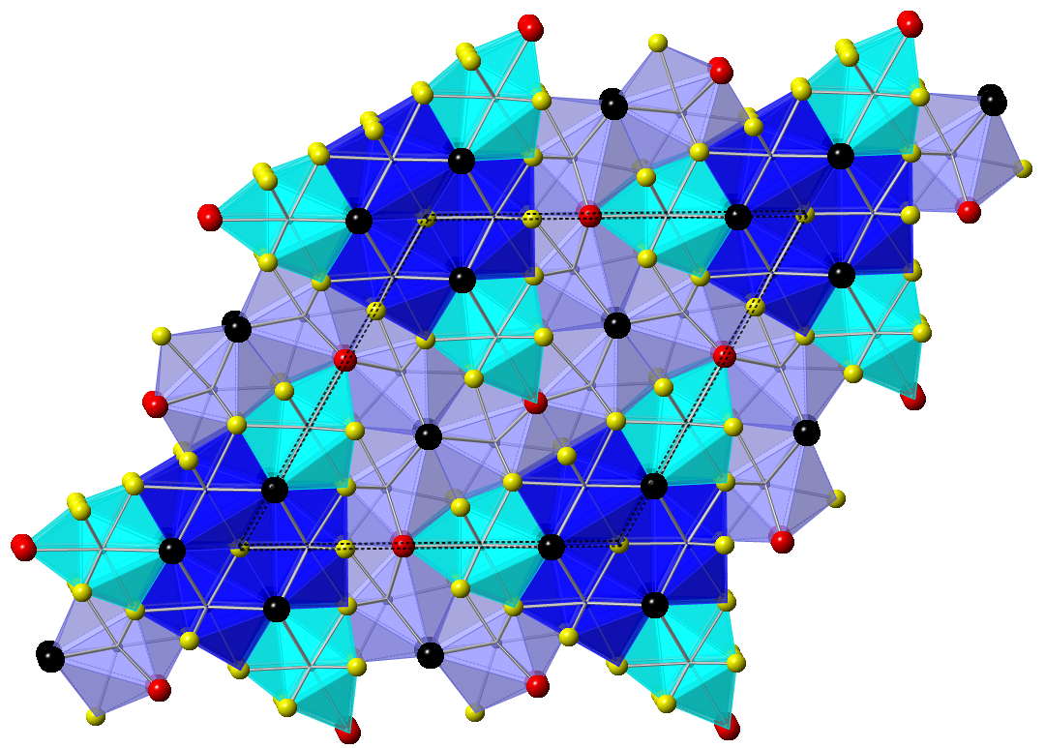
A_{5+x}Mg_{19-x}Si₁₂ (A = Sr, Ba, Eu)
Ho₅Ni₁₉P₁₂ type
A in the Ho sites,
Mg in the Ni sites,
Si in the P sites
Hexagonal, P-62m
●A ●Mg ●Si ●A/Mg
3f mixed site:
Smaller A²⁺ can mix on this Mg site (Ba²⁺ can’t fit)
Charge-balanced: (A²⁺/Mg²⁺)₂₄(Si⁴⁻)₁₂
compound | Cell parameters (Å)
Ba₅Mg₁₉Si₁₂ | a = 14.6392, c = 4.4775
Sr_{7.82}Mg_{16.18}Si₁₂ | a = 14.8076, c = 4.4720
Eu₈Mg₁₆Si₁₂ | a = 14.882, c = 4.4863

Slide 16
A/A’/Mg/Si semi-metallic silicides
What happens if you use more than one A element?
CaMgSi
A = Ca
Mg/Zn + Si + A
A = Yb
Yb₂MgSi₂
A = Sr
A = Eu
A = Ba
Sr_{5+x}Mg_{19-x}Si₁₂
Eu_{5+x}Mg_{19-x}Si₁₂
Ba₅Mg₁₉Si₁₂

Slide 17
A_{5+x}Mg_{19-x}Si₁₂ (A = Sr, Ba)
Different amounts of Ba + Sr reacted with 3 mmol Si in Mg/Zn flux (22:8 mmol)
All products have Ho₅Ni₁₉P₁₂ structure type
Ba goes on Ho sites only
Sr goes on Ho sites and mixes on one Ni site
Ba mmol | Sr mmol | Product | a (Å) | c (Å) | Volume (Å³)
3 | 0 | Ba₅Mg₁₉Si₁₂ | 14.6392(2) | 4.47754(9) | 831.00(3)
2.25 | 0.75 | Ba_{4.86}Sr_{2.94}Mg_{16.20}Si₁₂ | 14.9113(3) | 4.5507(1) | 876.27(4)
1.5 | 1.5 | Ba_{3.63}Sr_{4.20}Mg_{16.17}Si₁₂ | 14.9063(2) | 4.5382(1) | 873.28(3)
0.75 | 2.25 | Ba_{1.93}Sr_{5.99}Mg_{16.08}Si₁₂ | 14.8730(4) | 4.5082(2) | 863.64(6)
0 | 3 | Sr_{7.82}Mg_{16.18}Si₁₂ | 14.8076(4) | 4.4720(1) | 849.18(5)
Zarei, A.; Uddin, M.S.; Baumback, R.; Wei, K.; Latturner, S.E.; Inorg. Chem., 2024, submitted.

Slide 18
(Ba/Sr)_{5+x}Mg_{19-x}Si₁₂ Electronic Properties
Ba₅Mg₁₉Si₁₂ (well ordered, no site mixing) is semiconducting with E_{g} = 0.02 eV.
Sr_{7.82}Mg_{16.18}Si₁₂ and Ba_{3.6}Sr_{4.2}Mg_{16.2}Si₁₂ are metallic

Slide 19
(Ba/Sr)_{5+x}Mg_{19-x}Si₁₂ Thermal Conductivity
Thermal conductivity is sum of electron contribution and lattice contribution κ_{tot} = κ_{elec} + κ_{latt}
κ_{elec} directly proportional to conductivity; can be calculated; subtracted from κ_{tot} to get lattice contribution
More disorder and rattling atoms → lower κ_{latt}

Slide 20
(Ba/Sr)_{5+x}Mg_{19-x}Si₁₂
Thermoelectric figure of merit:
Lowest for Ba₅Mg₁₉Si₁₂
Higher for the analogs with more disorder (Sr/Mg and Sr/Ba mixing)
Need high temp measurements!
Improve zT by lowering κ_{latt}
Heavier atoms (Yb, Eu?)
More rattling (Ca mixing?)
More complex structures?

Slide 21
(A/A’/Mg)₂Si semi-metallic silicides
What happens if you use more than one A element?
CaMgSi
A = Ca
Mg/Zn + Si + A
A = Yb
Yb₂MgSi₂
A = Sr
A = Eu
A = Ba
Sr_{5+x}Mg_{19-x}Si₁₂
Eu_{5+x}Mg_{19-x}Si₁₂
Ba₅Mg₁₉Si₁₂

Slide 22
Ca/Ba/Mg/Si (Taylor’s version)
Different amounts of Ba + Ca reacted with 3 mmol Si in either Mg/Al or Mg/Zn flux (22:8 mmol)
Ca:Ba mmol amounts
3:0 2:1 1.5:1.5 1:2 3:0
CaMgSi
Ba₅Mg₁₉Si₁₂
CaMgSi + Ba₂Ca₂Mg₁₀Si₇
Ba₅Mg₁₉Si₁₂ type
Ba₂Ca₂Mg₁₀Si₇ + Ba₅Mg₁₉Si₁₂ type

Slide 23
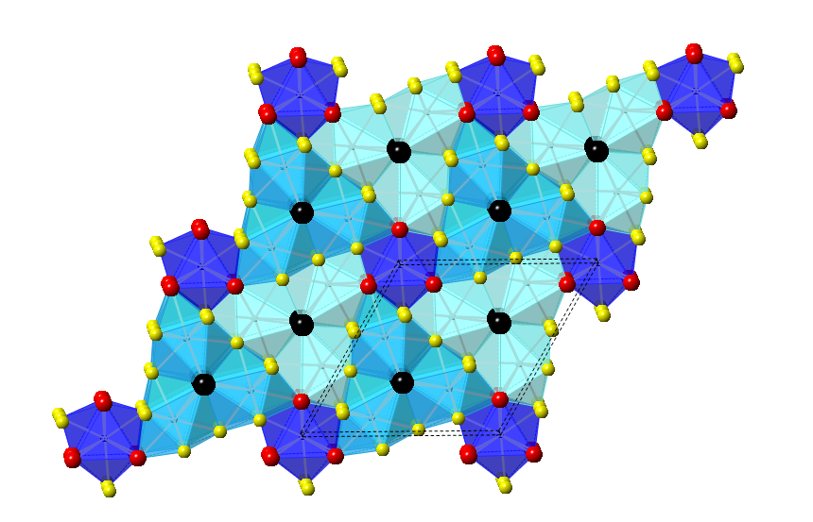
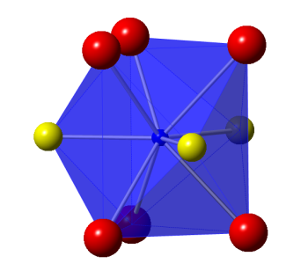
Ba₂Ca_{2.3}Mg_{9.7}Si₇
Zr₂Fe₁₂P₇ type
hexagonal, P-6; a = 11.196(2) Å, c = 4.4595(9) Å
Ba in the Zr sites, Si in the P sites, Mg in the Fe sites
Ca mixes on one Mg site
Si1
Ba
Ca/Mg
Si3
Si2
Mg
Si
Silsby, K.; Latturner, S.E.; Kauzlarich, S.M. Chem. Mater., 2015, 27, 6708-6716

Slide 24
Ba₂Ca_{2.3}Mg_{9.7}Si₇
Charge-balanced Zintl phase: (Ba²⁺/Ca²⁺/Mg²⁺)₁₄(Si⁴⁻)₇
Band structure calculations indicate semiconductor/semimetal

Slide 25
Ba₂Ca_{2.3}Mg_{9.7}Si₇ electrical properties
Increasing resistivity as temperature rises (metallic/semimetallic)
Low thermal conductivity
Silsby, K.; Kauzlarich, S.M.; Latturner, S.E. Chem. Mater., 2015, 27, 6708-6716

Slide 26
Ba₂Ca_{2.3}Mg_{9.7}Si₇ thermoelectric properties
High Seebeck coefficient; n-type
ZT = S²T/ρκ
Maximum of 0.4 at 900 K
Improvements likely if substituted or doped

Slide 27
Conclusions / Future Work
Flux reactions enable crystal growth of metal silicides
Semi-metallic silicide Zintl phases show promise as thermoelectric compounds
Improve zT by lowering κ_{latt}
Heavier atoms (Yb, Eu?)
More disorder (site mixing)
Rattling of small cations mixed on large cation sites
More complex structures?
zT likely higher at high temperature; need high temp measurements!

Slide 28
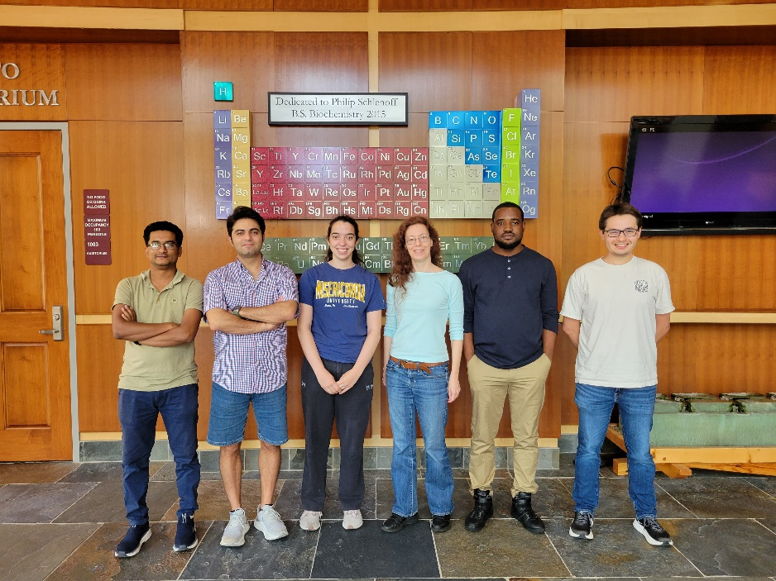
Acknowledgments
Xiaowei Ma, Kurt Silsby, Milorad Stojanovic, Jeff Whalen, Guillermo Vasquez, Jo Haddock, Olufemi Araoyimbo, Amir Zarei, Taylor Walker
Susan Kauzlarich (UC Davis)
Kaya Wei and Ryan Baumbach (NHMFL)

Slide 29
Large family of (A/A’/Mg)₂Si from flux growth
Compound | Structure type | Space group | Unit cell parameters (Å)
Ba_{1.9}Ca_{2.4}Mg_{9.7}Si₇ | Zr₂Fe₁₂P₇ | P-6 | a = 11.196(2) c = 4.4595(9)
Ba₂Yb_{0.88}Mg_{11.12}Si₇ |  |  | a = 11.0830(6) c = 4.4150(3)
Eu₂Yb_{1.11}Mg_{10.89}Si₇ |  |  | a = 10.9910(7) c = 4.3250(3)
Sr₅Mg₁₉Si₁₂ | Ho₅Ni₁₉P₁₂ | P-62m | a = 14.457(1) c = 4.3713(4)
Ba₅Mg₁₉Si₁₂ |  |  | a = 14.5874(8) c = 4.4662(2)
Eu_{7.5}Mg_{16.5}Si₁₂ |  |  | a = 14.668(5) c = 4.428(1)
Ba₅Eu_{2.85}Mg_{16.15}Si₁₂ |  |  | a = 14.857(2) c = 4.5225(5)
Ba_{3.4}Sr_{4.5}Mg₁₆Si₁₂ |  |  | a = 14.862(9) c = 4.521(2)
Sr_{4.8}Ca_{3.2}Mg₁₆Si₁₂ |  |  | a = 14.666(2) c = 4.4187(7)
Ba₅Yb_{2.26}Mg_{16.73}Si₁₂ |  |  | a = 14.8223(8) c = 4.5174(3)
Eu₅Yb₂Mg₁₇Si₁₂ |  |  | a = 14.526(2) c = 4.3800(6)
Sr₅Eu_{1.39}Mg_{17.61}Si₁₂ |  |  | a = 14.553(2) c = 4.4102(7)
Ba₆Yb_{1.84}Mg_{18.16}Si₁₃ | Zr₆Ni₂₀P₁₃ | P-6 | a = 15.455(1) c = 4.5046(3)
Ba₆Eu₃Mg₁₇Si₁₃ |  |  | a = 15.482(1) c = 4.5082(3)
Ba₂₀Yb_{4.7}Mg_{61.3}Si₄₃ | Ho₂₀Ni₆₆P₄₃ | P6₃/m | a = 27.928(4) c = 4.4808(6)
Ba₂₀ Eu_{5.6}Mg_{60.4}Si₄₃ |  |  | a = 27.988(3) c = 4.4915(6)
Ba₂₀Mg₆₆Si₄₃ |  |  | a = 27.805(4) c = 4.4741(6)

